Slide 1

Bank Customer Churn Prediction
T Bharadwaj

Slide 2
Problem statement
The Bank Customer Churn Prediction problem aims to predict which customers of a bank are likely to terminate their relationship with the bank. Customer churn can be a significant problem for banks, as it can lead to a loss of revenue and market share.
The dataset for this problem typically includes various customer attributes, such as credit score, balance, and salary, among others. The target variable is a binary indicator that represents whether a customer has churned or not.
The goal of this problem is to develop a predictive model that can accurately identify which customers are likely to churn, based on their historical interactions with the bank. This model can be used to proactively identify customers who are at risk of churning and develop targeted retention strategies to keep them engaged with the bank.

Slide 3
Objective
The objective of bank customer churn prediction is to identify customers who are at risk of leaving a bank and taking their business elsewhere. Churn prediction models analyze customer data and behavior to identify patterns that are indicative of potential churn. By predicting churn in advance, banks can take proactive measures to retain customers, such as offering targeted promotions or incentives, improving customer service, or addressing any underlying issues that may be causing dissatisfaction. This can help banks to reduce customer churn, improve customer satisfaction and loyalty, and ultimately increase profitability.

Slide 4
Methodology
Data Collection
The dataset was taken through an competition hosted by Driven Data
Data Preparation
Preprocess the dataset by removing any duplicates, missing values, or inconsistent data.
Model Selection
Choose a suitable machine learning algorithms to train the model
Feature Engineering
Analyze the dataset and extract relevant features that are likely to impact earthquake damage
Transform and scale the features appropriately, for example, by standardizing or normalizing them.
Model Training
Train the selected model using the prepared dataset
Use appropriate techniques to prevent overfitting, such as regularization, early stopping, or dropout Use appropriate techniques to prevent overfitting, such as regularization, early stopping, or dropout.
Model Evaluation
Evaluate the performance of the trained model on the testing set
Use appropriate metrics, such as F1 square, Precision, Recall, to measure the model's accuracy and generalization ability.

Slide 5
About the dataset
This dataset is for ABC Multistate bank with following columns:
customer_id, unused variable.
credit_score, used as input.
country, used as input.
gender, used as input.
age, used as input.
tenure, used as input.
balance, used as input.
products_number, used as input.
credit_card, used as input.
active_member, used as input.
estimated_salary, used as input.
churn, used as the target. 1 if the client has left the bank during some period or 0 if he/she has not.

Slide 6
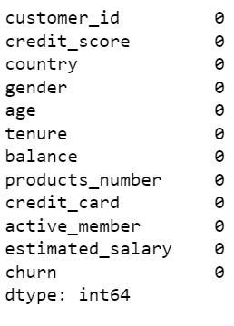
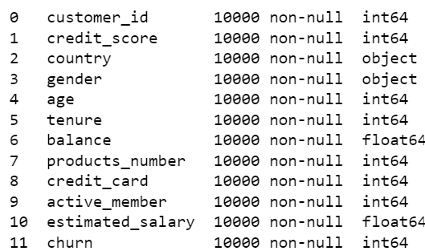
Data preparation
No missing values
11 columns with churn column being the target variable

Slide 7
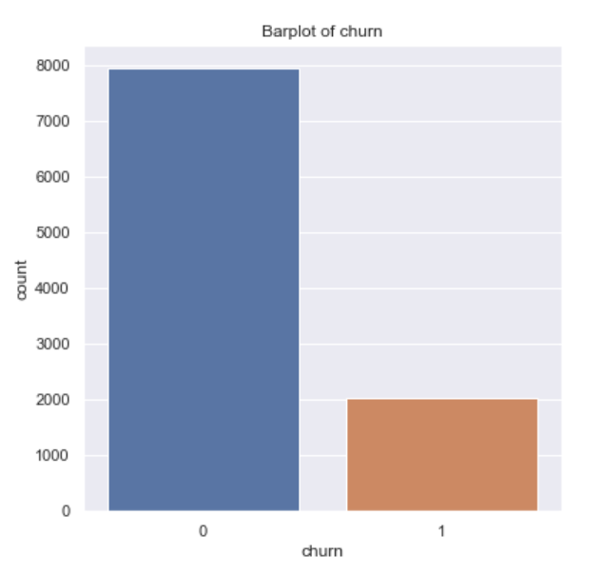
EDA
From the plot it is very clear that the target variable data is heavily imblanced with 1 being very largely under represented compared to grade 0
It is important to note that we have to balance this data so as to use models like decision tress and random forests as these models are extremely sensitive towards imbalanced data
Plot 1
Distribution of target/dependent variable, churn

Slide 8
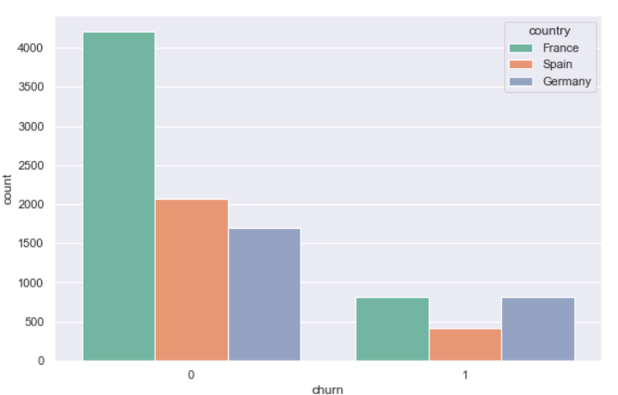
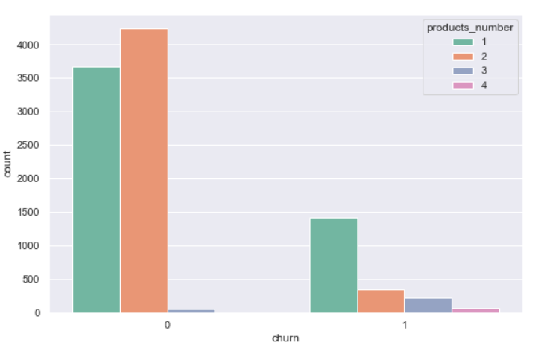
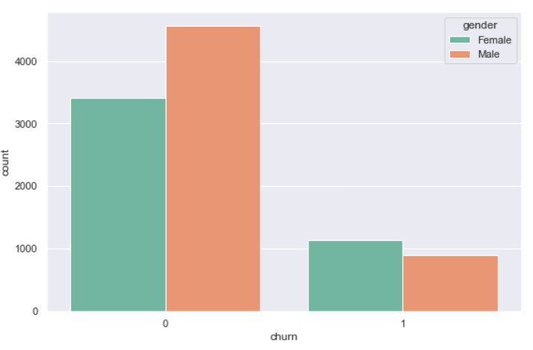
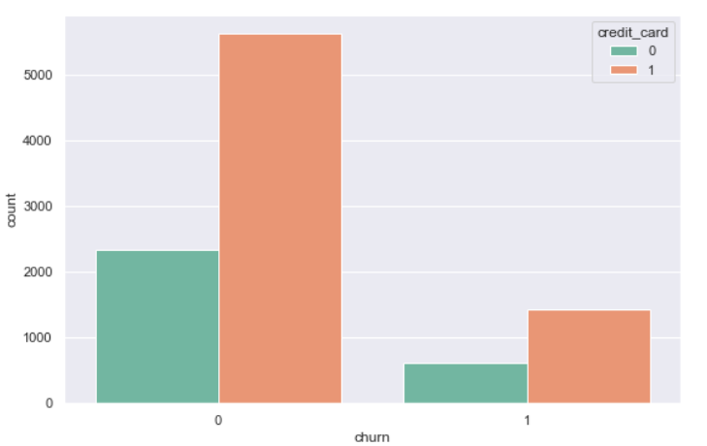
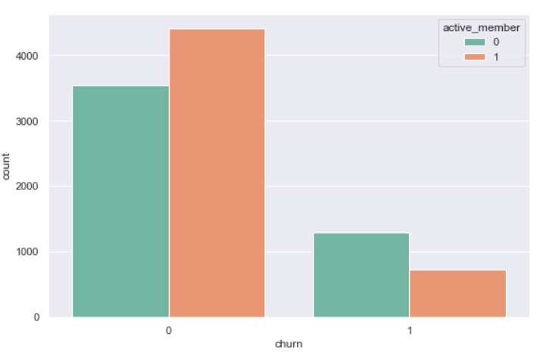
Relationships of target variable with other variables
Plot 2
Plot 3
Plot 4
In our bivariate analysis we were able to get some insights, product 2 despite having a lot of samples generally does not have a churn problem, men and women are well distributed in churn values, and the other variables are also well distributed.
Plot 5
Plot 6

Slide 9
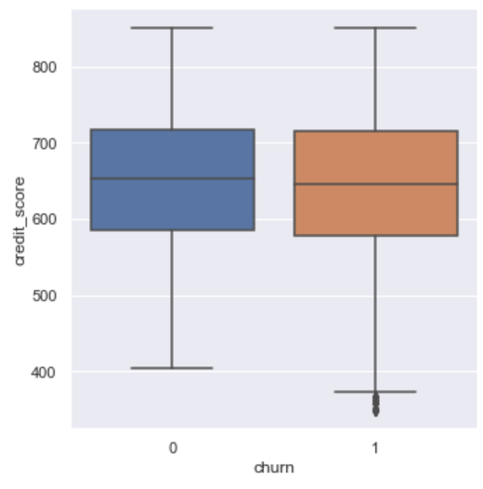
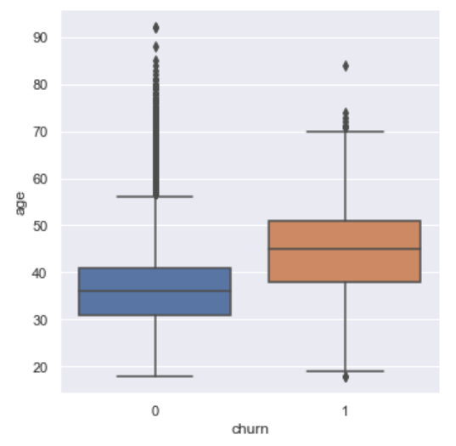
Plot 7
Plot 8
Looking at the age variable, we can see that older people are generally more prone to churn
When we look at the credit score variable, we can't see much difference between the scores and the chance of churn.

Slide 10
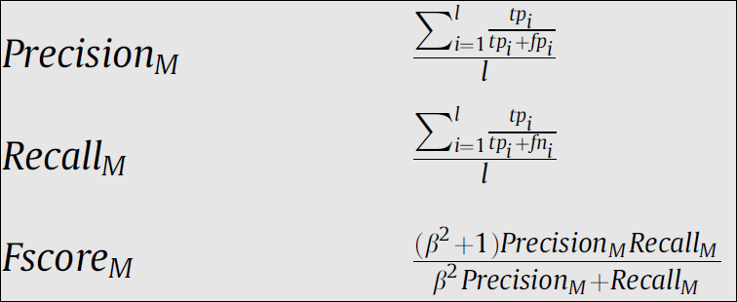
Data modeling
This stage involves training a machine learning model with all the given features to make predictions for the target variable churn.
To measure the performance of our algorithms, we’ll use the F1 score which balances the precision and recall of a classifier or we can use accuracy also.

Slide 11
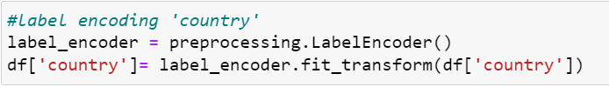
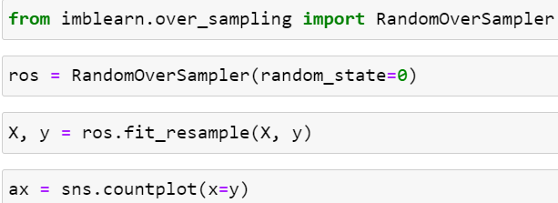

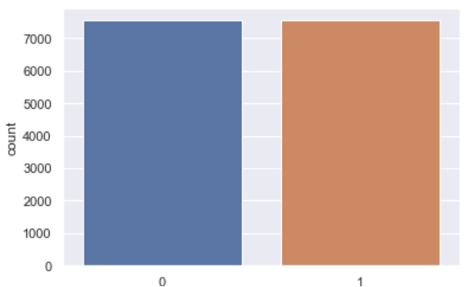
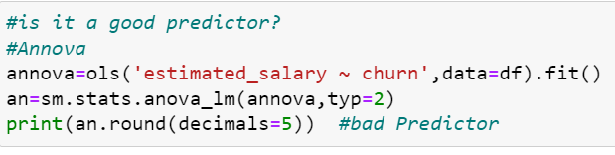
Before the model is fitted on the data necessary feature transformation was performed on the data which include the following;
Feature scaling
Converting categorical columns into numerical using label encoding
Performing statistical tests like ANNOVA and CHI-SQUARE tests
Balanceing the imbalanced target variable
Outliers Handling
Plot 9

Slide 12
Finally the data was split into train and test data and the followings models were used in the project:
Logistic classification
Random Forests
Decision Tree
Adaptive Boosting
GradBoost
KNN
Naïve Bayes
SVM

Slide 13
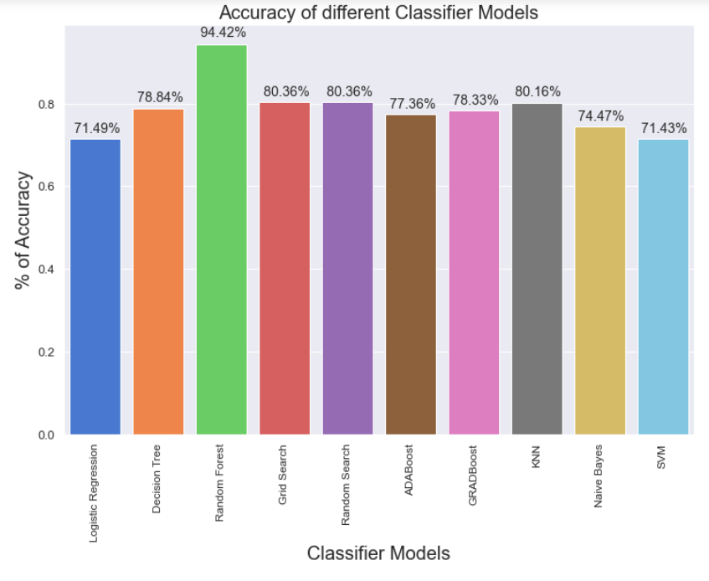
Plot 10
It is clear from the above plot that Random Forest gives the best accuracy

Slide 14
How Helpful is it?
Bank customer churn prediction can be very helpful for banks and financial institutions. Churn prediction is the process of identifying customers who are likely to stop using a bank's products or services. By predicting churn, banks can take proactive measures to retain customers, improve customer satisfaction, and reduce customer acquisition costs.
Some of the benefits of bank customer churn prediction include:
Retaining customers: By identifying customers who are likely to leave, banks can take proactive measures to retain them, such as offering incentives, improving customer service, or providing customized solutions.
Improving customer satisfaction: By addressing the concerns of customers who are at risk of churning, banks can improve customer satisfaction and loyalty.
Reducing customer acquisition costs: Acquiring new customers can be expensive, so it makes sense for banks to focus on retaining existing customers
Increasing profitability: By reducing churn, banks can increase their profitability by retaining high-value customers and reducing the costs associated with customer acquisition.

Slide 15


